Slide 1
Mergers & takeovers (acquisitions)

Slide 2
Merger:
Combination of two separate entity & creation of one reporting entity
Take over:
The acquisition of controlling interest in the voting share capital of another company

Slide 3
Mergers and acquisitions involve many issues, including
Corporate governance.
Form of payment.
Legal issues.
Contractual issues.
Regulatory approval.

Slide 4
Reasons for mergers & acquisitions
Main Reason: Synergy
Where present value of the combines enterprise is greater than the sum of present value of the individual companies
i.e 2+2=5
Synergy= VAB- ( VA+VB)
Because combined entity results provide better return that was being achieved as by the same resources used in two separate companies
Type of synergies
  Operating
  Financial
  Other effects

Slide 5
SYNERGY
Suppose Firm A is contemplating acquiring Firm B. The acquisition will be beneficial if the
combined firm will have greater value than the sum of the values of the separate fi rms. If
we let VAB stand for the value of the merged firm, then the merger makes sense only if:
V AB > V A + VB
Where V A and V B are the separate values. A successful merger thus requires that the value of the whole exceed the sum of the parts.
The difference between the value of the combined firm and the sum of the values of the firms as separate entities is the incremental net gain from the acquisition, V = VAB - (VA + VB) When V is positive, the acquisition is said to generate synergy .

Slide 6
Example for synergy
Suppose that the “A” Company has made an offer for the “B” Company that consists of the purchase of 1 million shares at $20 per share. The value of “B” Company stock before the bid was made public was $15 per share. “A” Company stock is trading at $40 per share, and there are 10 million shares outstanding. “A” Company estimates that it is likely to reduce costs through economics of scale with this merger of $3 million per year, forever. The appropriate discount rate for these gains is 10%.
What are the synergistic gains from this merger?

Slide 7
Other reasons
Diversification
Revenue Enhancement
Cost Reductions
Tax Savings
Reductions in capital needs
Bootstrapping earnings
Finance & liquidity
Asset backing
Growth
Defensive merger

Slide 8
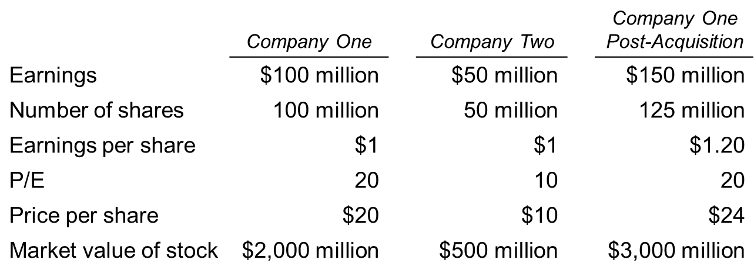
Bootstrapping earnings
Bootstrapping earnings is the increase in earnings per share as a result of a merger, combined with the market’s use of the pre-merger P/E to value post-merger EPS.
i. e: Company “ One” offers 1 share for each 2 shares of Company “ Two”
If Market applies pre-merger P/E of Company One to post-merger earnings.

Slide 9
Factors need to consider in a takeover decision
Price Factor
  Cost of the acquisition
  Whether acquisition worth for price
  How to determine the value of the business
        Earnings
        Assets
        prospects sales & growth
        How it would contribute to the strategy of the predator company
        Other Factors
          Whether takeover desirable by the predator companies shareholders
          Are the target company amenable to the takeover
          Form of the purchase consideration take
          How would takeover be reflected in public accounts
          Any other potential problems

Slide 10
Basic form of acquisitions-
Purchase of Shares of the target company
  Shareholders shares target company simply be bought back
  Example
  “A” company is going to acquire “ B” Company for $400Mn Cash
  Determine the takeover is worth for “ A” Ltd

Slide 11
Share Exchange
Acquiring company will issuing shares to the target company
“ A” Company will acquire “ B” company & A will issue shares to B Company shareholders in exchange of their shares
Raise cash on the share market & used it to by shares of the target company shares

Slide 12
Example 01
“A Ltd is going to acquire “ B” Ltd. “ B” agree for share for share exchange & “ B” Share holders will receive 25% premium on their current market price
Determine the number of new shares issued to “ B” Ltd

Slide 13
Example 02
“A Ltd is going to acquire “ B” Ltd. “ B” agree for share for share exchange. The market price of shares are regarded as accurate reflection of their intrinsic value. The takeover expected to have cost saving which have present value of 12million.
Bid offer: one share of “ A” for every thee shares of “ B”
Calculate the wealth of the shareholder who owns 1000 shares

Slide 14
Example 03
“A” Plc & “ B” Plc are listed companies

Slide 15
Evaluating Bidder
The acquiring firm shareholders want to minimize the amount paid to target shareholders, not paying more than the pre-merger value of the target plus the value of the synergies.
The target shareholders want to maximize the gain, accepting nothing below the pre-merger market value

Slide 16
Evaluating Formula
Target shareholders’ gain = Premium = P_{T} – V_{T} (10-7)
where
  P_{T} = price paid for the target company
  V_{T} = pre-merger value of the target company
Acquirer’s gain = Synergies – Premium = S – (P_{T} – V_{T}) (10-8)
where
  S = synergies created by the business combination
V_{A*} = V_{A} + V_{T} + S – C (10-9)
where
  V_{A*} = post-merger value of the combined companies
  V_{A} = pre-merger value of the acquirer
  C = cash paid to target shareholders

Slide 17
i.e
Suppose that the “A” Company has made an offer for the “B” Company that consists of the purchase of 1 million shares at Rs 20 per share. The value of “B” Company stock before the bid was made public was Rs 15 per share. “A” Company stock is trading at Rs.40 per share, and there are 10 million shares outstanding. “A” Company estimates that it is likely to reduce costs through economics of scale with this merger of Rs.3 million per year, forever. The appropriate discount rate for these gains is 12%.
What are the synergistic gains from this merger?
What parties, if any, share in these gains?
What is the estimated value of the “A” Company post-merger?

